Slide 1
System and Cyber Security
L. Budi Handoko, M.Kom. (handoko@dosen.dinus.ac.id /
handoko@dsn.dinus.ac.id)
Dian Nuswantoro University

Slide 2

Social Engineering
People can be just as dangerous as unprotected computer systems
People can be lied to, manipulated, bribed, threatened, harmed, tortured, etc. to give up valuable information
Most humans will breakdown once they are at the “harmed” stage, unless they have been specially trained
Think government here…

Slide 3
Social Problems
Fun Example 1:
“Hi, I’m your AT&T rep, I’m stuck on a pole. I need you to punch a bunch of buttons for me”

Slide 4
Social Problems
Fun Example 2:
Someone calls you in the middle of the night
“Have you been calling Egypt for the last six hours?”
“No”
“Well, we have a call that’s actually active right now, it’s on your calling card and it’s to Egypt and as a matter of fact, you’ve got about $2000 worth of charges on your card and … read off your AT&T card number and PIN and then I’ll get rid of the charge for you”

Slide 5
Social Problems
Fun Example 3:
Who saw Office Space?
In the movie, the three disgruntled employees installed a money-stealing worm onto the companies systems
They did this from inside the company, where they had full access to the companies systems
What security techniques can we use to prevent this type of access?
Notes:
Security techniques: IDS can be configured to look for internal inconsistencies in traffic patterns
Firewalls can be configured to block off one part of a corporate network from another part to further restrict access
Can also use hardware based identification tokens with strong encryption to identify who is doing what

Slide 6
Social Engineering
There aren’t always solutions to all of these problems
Humans will continue to be tricked into giving out information they shouldn’t
Educating them may help a little here, but, depending on how bad you want the information, there are a lot of bad things you can do to get it
So, the best that can be done is to implement a wide variety of solutions and more closely monitor who has access to what network resources and information
But, this solution is still not perfect

Slide 7
Types / Technique of Social Engineering
Phising
Vishing (Voice Phising)
Pretexting
Baiting
Tailgating
Impersonation
Quid Pro Quo
Elicitation
Scareware
Friendship Request
Pharming
Reverse Social Engineering
etc.

Slide 8
System and Network Threats
Some systems “open” rather than secure by default
Reduce attack surface
But harder to use, more knowledge needed to administer
Network threats harder to detect, prevent
Protection systems weaker
More difficult to have a shared secret on which to base access
No physical limits once system attached to internet
Or on network with system attached to internet
Even determining location of connecting system difficult
IP address is only knowledge

Slide 9
Port scanning
Automated attempt to connect to a range of ports on one or a range of IP addresses
Detection of answering service protocol
Detection of OS and version running on system
nmap scans all ports in a given IP range for a response
nessus has a database of protocols and bugs (and exploits) to apply against a system
Frequently launched from zombie systems
To decrease trace-ability
Denial of Service
Overload the targeted computer preventing it from doing any useful work
Distributed denial-of-service (DDOS) come from multiple sites at once
Consider the start of the IP-connection handshake (SYN)
How many started-connections can the OS handle?
Consider traffic to a web site
How can you tell the difference between being a target and being really popular?
Accidental – CS students writing bad fork() code
Purposeful – extortion, punishment

Slide 10

Dictionary Attack
We can run a dictionary attack on the passwords
The passwords in /etc/passwd are encrypted with the crypt(3) function (one-way hash)
Can take a dictionary of words, crypt() them all, and compare with the hashed passwords
This is why your passwords should be meaningless random junk!
For example, “sdfo839f” is a good password
That is not my andrew password
Please don’t try it either

Slide 11

Packet Sniffing
Recall how Ethernet works …
When someone wants to send a packet to some else …
They put the bits on the wire with the destination MAC address …
And remember that other hosts are listening on the wire to detect for collisions …
It couldn’t get any easier to figure out what data is being transmitted over the network!
This works for wireless too!
In fact, it works for any broadcast-based medium

Slide 12
Packet Sniffing
What kinds of data can we get?
Asked another way, what kind of information would be most useful to a malicious user?
Answer: Anything in plain text
Passwords are the most popular

Slide 13
Packet Sniffing
How can we protect ourselves?
SSH, not Telnet
Many people at CMU still use Telnet and send their password in the clear (use PuTTY instead!)
Now that I have told you this, please do not exploit this information
Packet sniffing is, by the way, prohibited by Computing Services
HTTP over SSL
Especially when making purchases with credit cards!
SFTP, not FTP
Unless you really don’t care about the password or data
Can also use KerbFTP (download from MyAndrew)
IPSec
Provides network-layer confidentiality

Slide 14
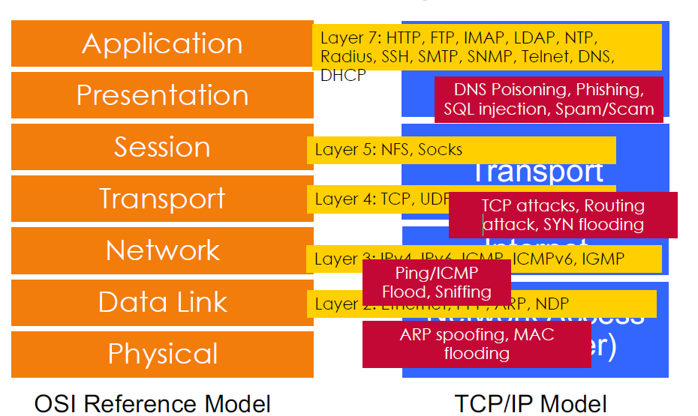
Attacks on Different Layers

Slide 15
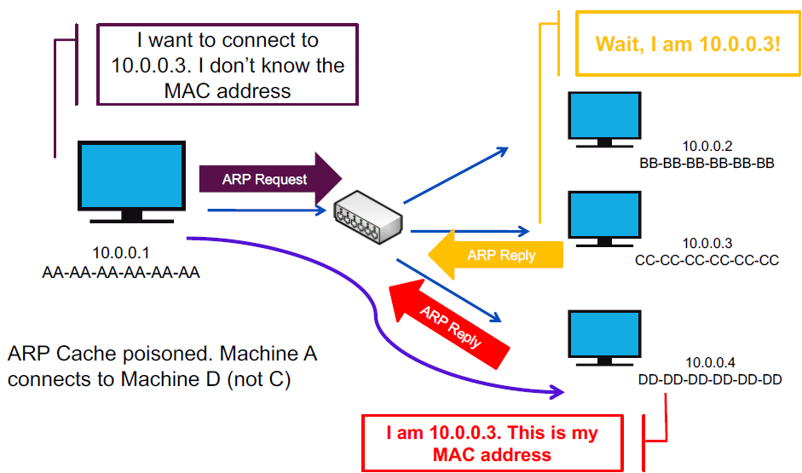
ARP Spoofing / ARP Poisoning

Slide 16
Tools
Defender Tools
Arpspoof (part of the DSniff suite of tools)
Arpoison
Subterfuge
Ettercap
Seringe
ARP-FILLUP -V0.1
arp-sk -v0.0.15
ARPOc -v1.13
arpalert -v0.3.2
arping -v2.04
arpmitm -v0.2
arpoison -v0.5
ArpSpyX -v1.1
ArpToXin -v 1.0
Cain and Abel
cSploit -v 1.6.2
SwitchSniffer
APE – ARP Poisoning Engine
Simsang
zANTI -v2
elmoCut
NetSec Framework -v1
Minary
NetCut (Also has a defense feature)
ARPpySHEAR
Agnitum Outpost Firewall
AntiARP
Antidote
Arp_Antidote
Arpalert
ArpON
ArpGuard
ArpStar
Arpwatch / ArpwatchNG
Colasoft Capsa
cSploit
elmoCut
Prelude IDS
Panda Security
remarp
Snort
Winarpwatch
XArp
Seconfig XP
zANTI
NetSec Framework
anti-arpspoof
DefendARP
NetCutDefender

Slide 17
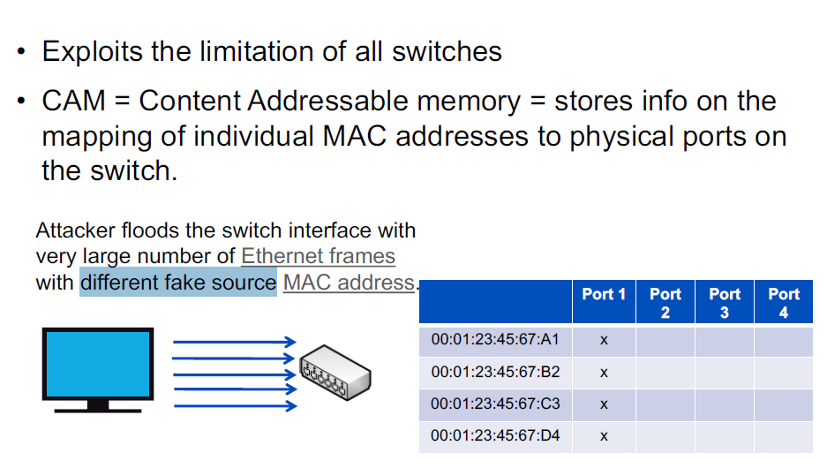
MAC Flooding

Slide 18
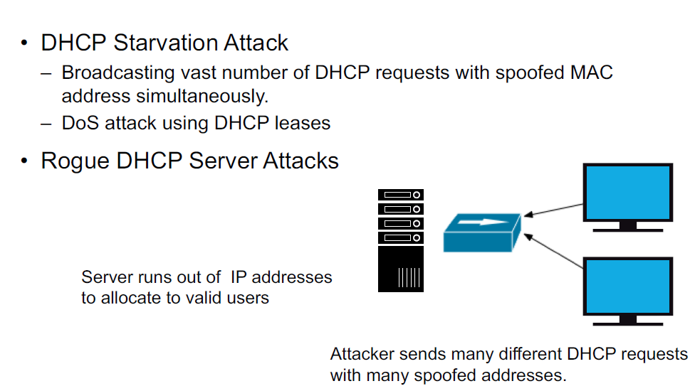
DHCP Attacks

Slide 19
Man in the Middle Attacks (Wireless)
Creates a fake access point and have clients authenticate to it instead of a legitimate one.
Capture traffic to see usernames, passwords, etc that are sent in clear text.
Beware of RedLine Stealer (Malware) – Sale on underground forums 100 – 150 USD depend on the version

Slide 20

Denial of Service
Purpose: Make a network service unusable, usually by overloading the server or network
Many different kinds of DoS attacks
SYN flooding
SMURF
Distributed attacks (DDoS)
Mini Case Study: Code-Red

Slide 21
Denial of Service
SYN flooding attack
Send SYN packets with bogus source address
Why?
Server responds with SYN ACK and keeps state about TCP half-open connection
Eventually, server memory is exhausted with this state
Solution: use “SYN cookies”
In response to a SYN, create a special “cookie” for the connection, and forget everything else
Then, can recreate the forgotten information when the ACK comes in from a legitimate connection
Notes:
Forge source IP so that the victim can’t figure out who you are.

Slide 22
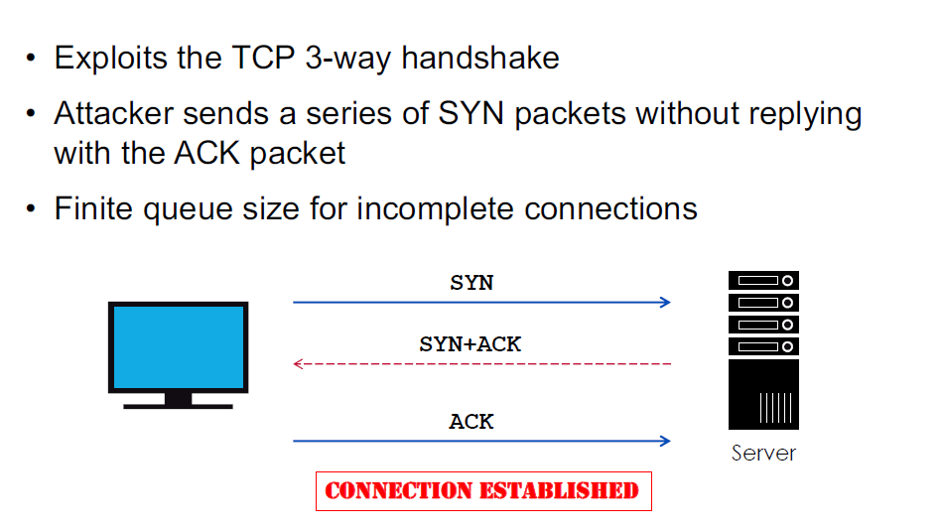
TCP Attacks

Slide 23
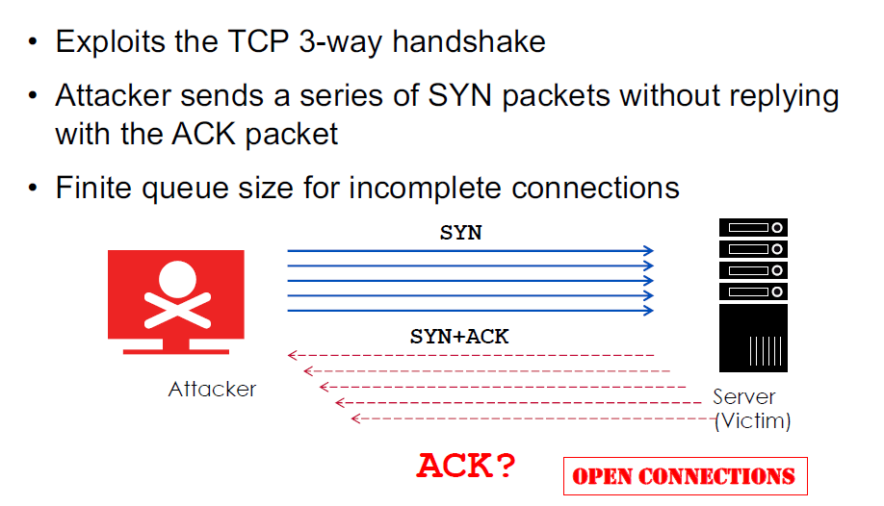
TCP Attacks

Slide 24
Denial of Service
SMURF
Source IP address of a broadcast ping is forged
Large number of machines respond back to victim, overloading it

Slide 25
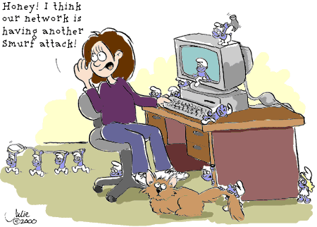
Denial of Service

Slide 26
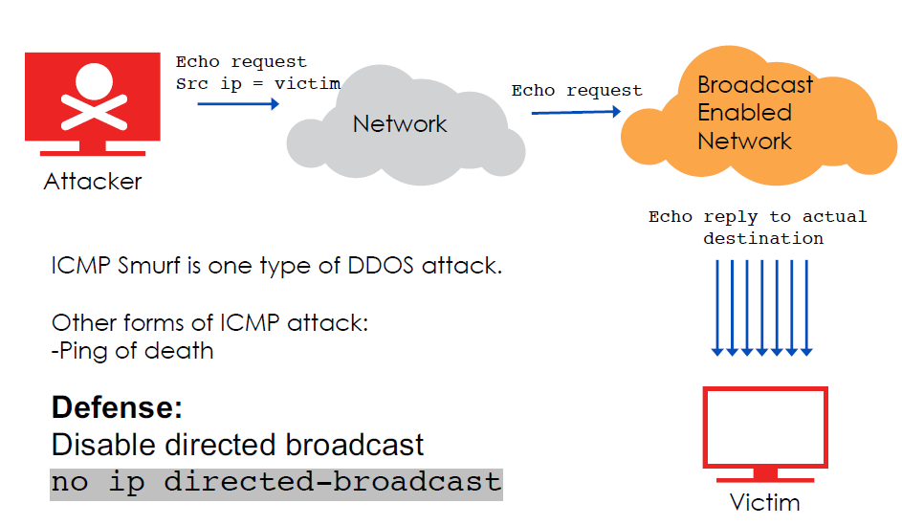
ICMP Smurf

Slide 27
Routing Attacks
Malicious route insertion
Poison routing table
To divert traffic and eavesdrop
Analyse / Modify / Drop packets
BGP attacks
Hijack prefixes
Temper the path information

Slide 28
Denial of Service

Slide 29
Denial of Service
Distributed Denial of Service
Same techniques as regular DoS, but on a much larger scale
Example: Sub7Server Trojan and IRC bots
Infect a large number of machines with a “zombie” program
Zombie program logs into an IRC channel and awaits commands
Example:
Bot command: !p4 207.71.92.193
Result: runs ping.exe 207.71.92.193 -l 65500 -n 10000
Sends 10,000 64k packets to the host (655MB!)
Read more at: http://grc.com/dos/grcdos.htm

Slide 30
Layer 7 DDoS Attack
Traditional DoS attacks focus on Layer 3 and Layer 4
In Layer 7, a DoS attack is targeted towards the applications disguised as legitimate packets
The aim is to exhaust application resources (bandwidth, ports, protocol weakness) rendering it unusable
Includes:
HTTP GET
HTTP POST
Slowloris
LOIC / HOIC
RUDY (R-U-Dead Yet)

Slide 31
Layer 7 DDoS Attack – Slowloris
Incomplete HTTP requests
Properties
Low bandwidth
Keep sockets alive
Only affects certain web servers
Doesn’t work through load balancers
Managed to work around accf_http

Slide 32
Denial of Service
Mini Case Study – CodeRed
July 19, 2001: over 359,000 computers infected with Code-Red in less than 14 hours
Used a recently known buffer exploit in Microsoft IIS
Damages estimated in excess of $2.6 billion
Why is this under the Denial of Service category?
CodeRed launched a DDOS attack against www1.whitehouse.gov from the 20th to the 28th of every month!
Spent the rest of its time infecting other hosts

Slide 33
Denial of Service
How can we protect ourselves?
Ingress filtering
If the source IP of a packet comes in on an interface which does not have a route to that packet, then drop it
RFC 2267 has more information about this
Stay on top of CERT advisories and the latest security patches
A fix for the IIS buffer overflow was released sixteen days before CodeRed had been deployed!

Slide 34
Another Kind of Network Attacks
DNS Changer
DNS Cache Poisoning
DNS Amplification
NTP Amplification
Routing Attacks
Ping of death
BGP Attacks / Prefix Hijack
… many more … etc …

Slide 35
Application Layer Attack
Scripting vulnerabilities
Cookie poisoning
Buffer overflow
Hidden field manipulation
Parameter tampering
Cross-site scripting
SQL injection
and so many
more …

Slide 36

Any Question ?
Anything to discuss ?

Slide 37


